Slide 1
To understand D3, imagine ninjas

Slide 2

Or, rather, a play about ninjas
Notes:
Say that you’re a theater director who’s putting on a play about ninjas

Slide 3
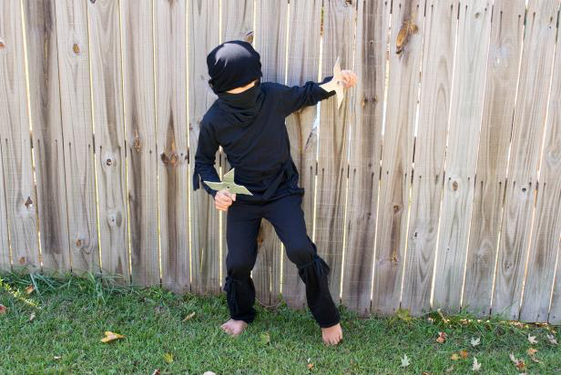
A NINJA requires two things
Actor + costume = NINJA
Notes:
We need both an actor and a costume to have a ninja who’s ready for the stage

Slide 4



3 costumes + 3 actors = 3 ninjas
+
=
Costumes + Actors = NINJAS
Notes:
If we have 3 costumes, but no actors, we do not have ninjas.
If we have 3 actors, but no costumes, we do not have ninjas.
We need 3 actors and 3 costumes to have 3 ninjas.

Slide 5

A NINJA requires two things
Actor only
= NO NINJA

Slide 6
Costume only = no ninja
Costume only
= NO NINJA

Slide 7
A NINJA requires two things
Actor + Costume
= NINJA

Slide 8

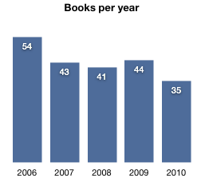
D3 charts are like ninjas
var books = [
{2006:54},
{2007:43},
{2008:41},
{2009:44},
{2010:35}
];
Notes:
Here, each piece of data in the array determines the appearance of each rectangle in the bar chart. The larger the number, the taller the rectangle.
Without the numbers in our array, we do not have a bar chart. That is why they are like actors.
Without the rectangles to represent the numbers, we do not have a bar chart. In that way, SVG elements are like ninja costumes.

Slide 9
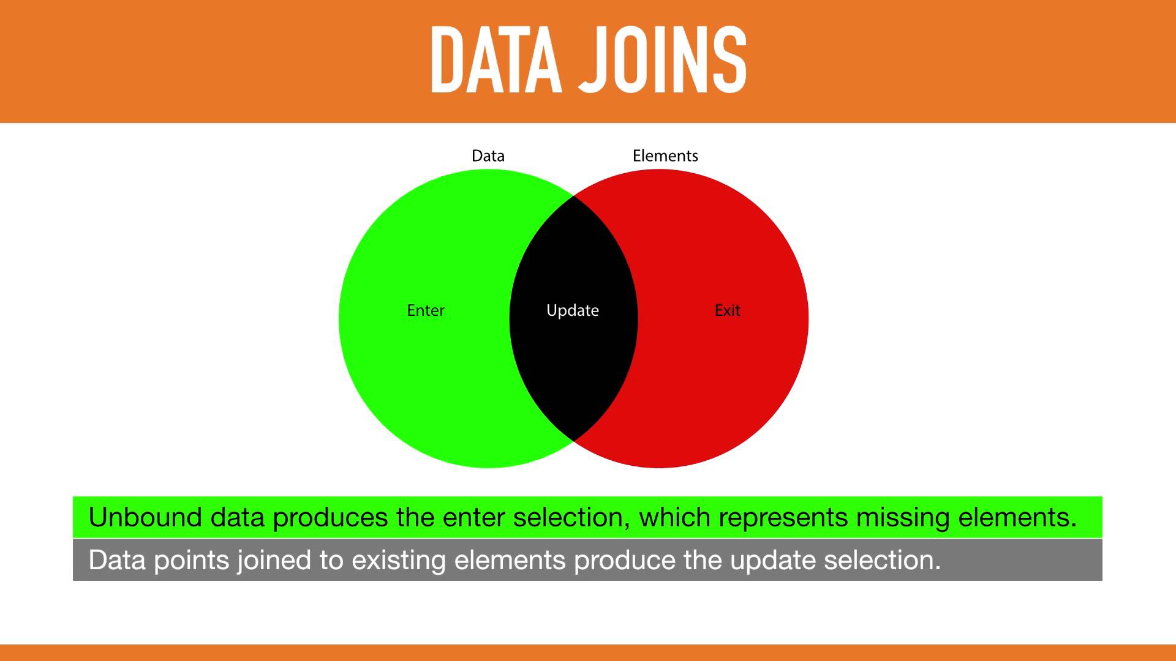
Enter(), Exit(), Update()
Notes:
-In D3, enter() selection means data that have not been joined to onscreen visual elements.
-Exit() selection represents visual elements that are not joined to data.
-And update() selection represents data that are bound to visual elements.

Slide 10

Enter() selection
Notes:
An enter() selection refers to pieces of data that have not yet been joined to visual elements.
To continue our analogy, it would be like actors who do not yet have their visual elements, i.e. costumes.

Slide 11
Enter() selection
var books = [
{2006:54},
{2007:43},
{2008:41},
{2009:44},
{2010:35}
];
Notes:
An enter() selection refers to pieces of data that have not yet been joined to visual elements.
To continue our analogy, it would be like actors who do not yet have their visual elements, i.e. costumes.

Slide 12
Exit() selection
Notes:
An exit() selection refers to pieces of data that have not yet been joined to visual elements.
To continue our analogy, it would be like costumes that do not have actors to wear them.

Slide 13
Exit() selection
Notes:
An exit() selection refers to pieces of data that have not yet been joined to visual elements.
To continue our analogy, it would be like costumes that do not have actors to wear them.

Slide 14
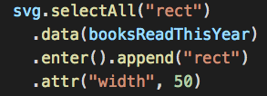
Bringing it all together
Notes:
-selectAll(“rect”) means that D3 scans the document for rectangles. If none exist, it notes so.
-With .data(booksReadThisYear), it joins the data to the rectangles.
-With .enter().append(“rect”), D3 identifies the enter() selection, or data that do not have rectangles joined to them, and appends a rectangle to each datum.

